Slide 1
Git & GitHub
By Muhammad Muneeb Ullah Khan

Slide 2
Git Introduction
What is Git?
Git is a popular version control system. It was created by Linus Torvalds in 2005, and has been maintained by Junio Hamano since then.
It is used for:
Tracking code changes
Tracking who made changes
Coding collaboration

Slide 3
Git install
You can download Git for free from the following website: https://www.git-scm.com/

Slide 4
Using Git with Command Line
To start using Git, we are first going to open up our Command shell.
For Windows, you can use Git bash, which comes included in Git for Windows. For Mac and Linux you can use the built-in terminal.
The first thing we need to do, is to check if Git is properly installed:
git --version

Slide 5
Configure Git
Now let Git know who you are. This is important for version control systems, as each Git commit uses this information:
git config --global user.name muneebkhan
git config --global user.email muneeb@aptechnk.com

Slide 6
Creating Git Folder
Now, let's create a new folder for our project:
mkdir learning_git
cd learning_git
mkdir makes a new directory.
cd changes the current working directory.

Slide 7
Initialize Git
git init
You just created your first Git Repository!
Must do initialization in your main folder after than open vs code and create some new files of html,css,php etc.

Slide 8
Git commands
Use ls command to list all files
To check status of file use git status
Now Git is aware of the file, but has not added it to our repository!
Files in your Git repository folder can be in one of 2 states:
Tracked - files that Git knows about and are added to the repository
Untracked - files that are in your working directory, but not added to the repository
When you first add files to an empty repository, they are all untracked. To get Git to track them, you need to stage them, or add them to the staging environment.

Slide 9
Git Staging Environment
One of the core functions of Git is the concepts of the Staging Environment, and the Commit.
As you are working, you may be adding, editing and removing files. But whenever you hit a milestone or finish a part of the work, you should add the files to a Staging Environment.
Staged files are files that are ready to be committed to the repository you are working on
git add index.html
git status
add all files in the current directory to the Staging Environment:
git add –all or git add -A

Slide 10
Git Commit
Since we have finished our work, we are ready move from stage to commit for our repo.
Adding commits keep track of our progress and changes as we work. Git considers each commit change point or "save point". It is a point in the project you can go back to if you find a bug, or want to make a change.
When we commit we should always include a message.
git commit -m "First release of Hello World!"

Slide 11
Git commands
To view the history of commits for a repository, you can use the log command
git log
To recover file from any recent changes use
git checkout index.html

Slide 12
Git -help See Options for a Specific Command
git commit –help
To list all possible commands, use the $ git help --all

Slide 13
Git Branch
Branches allow you to work on different parts of a project without impacting the main branch.
When the work is complete, a branch can be merged with the main project.
You can even switch between branches and work on different projects without them interfering with each other.
Branching in Git is very lightweight and fast!

Slide 14
Working with Git Branches
To create a new branch use git branch branch name
To switch between branches use git checkout branch name
To delete a branch use git branch –d branch name

Slide 15
GitHub
GitHub Account
Go to GitHub and sign up for an account:

Slide 16
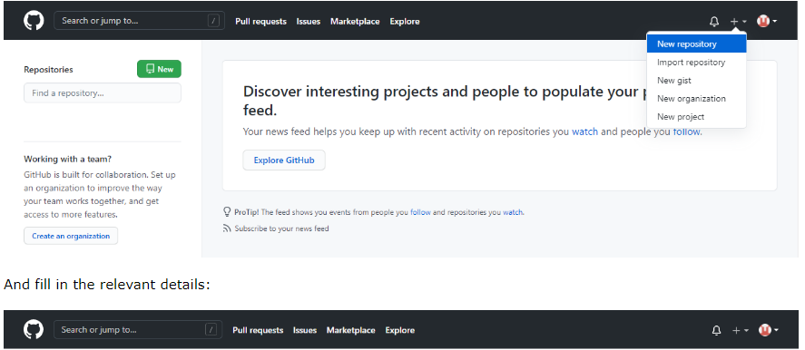
Create a Repository on GitHub

Slide 17
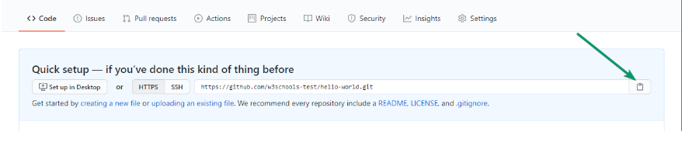
Push Local Repository to GitHub

Slide 18
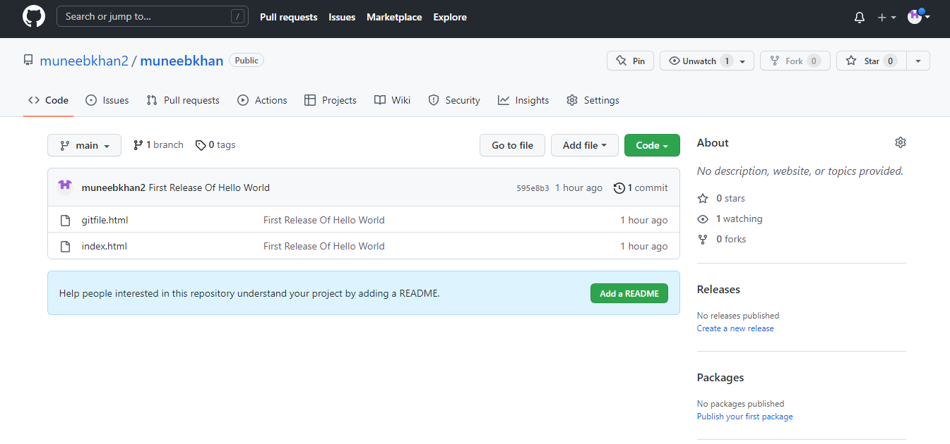
Push Local Repository to GitHub
git remote add origin url

